Slide 1
Data, Environment and Society Lecture 6: Exploratory Data Analysis and Data Cleaning
September 17, 2018
Instructor: Duncan Calllaway
GSI: Salma Elmallah

Slide 2
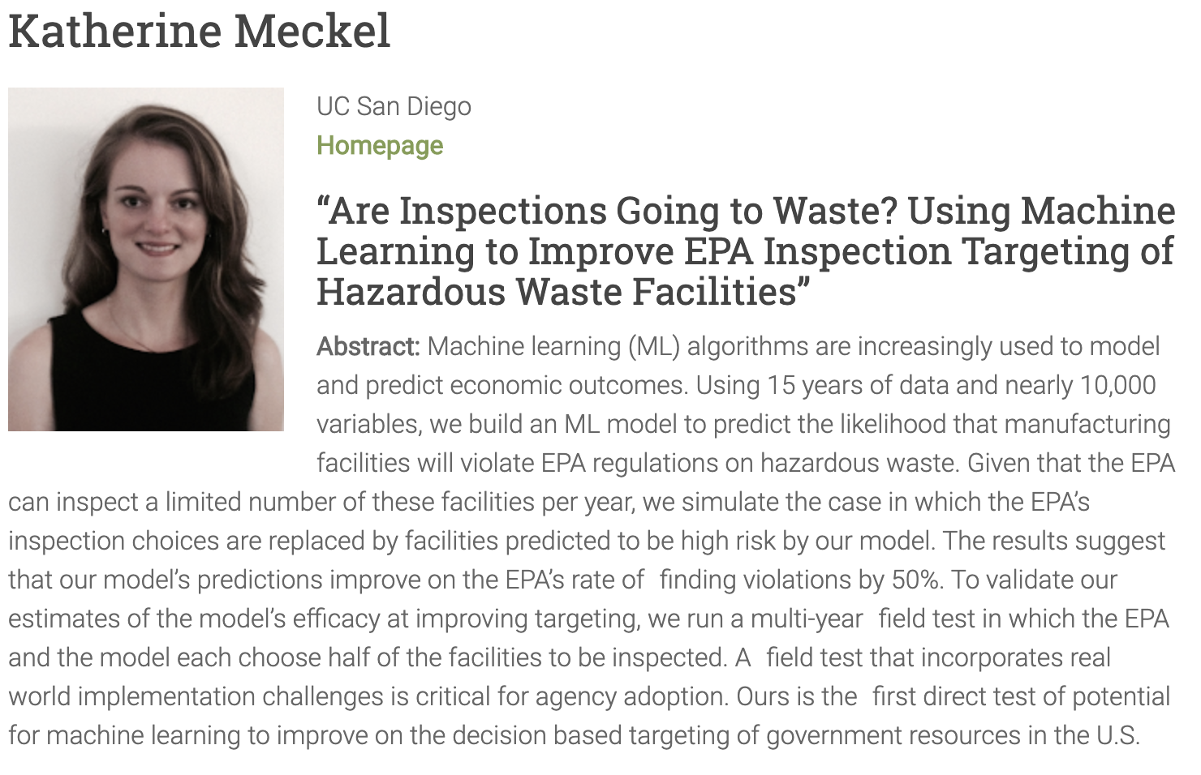
Seminar tomorrow, 88 Dwinelle, 12:10-1:30

Slide 3
Announcements
Reminders
Late policy
Lab 2 due yesterday, Lab 3 due next Monday
HW2 due Thursday
Next Thursday: Dan Kammen (ERG Professor) will speak about different populations’ access levels to photovoltaics in the US.

Slide 4
Upcoming reading
Today:
Hino et al, Pelletier et al
We will be using material from DS100 Ch4 and 5
Thursday: DS100 Ch6 textbook (visualization)
Next Tuesday: Ch 10 of DS100, Ch 2 of ISLR
Next Thursday: Sunter et al (Kammen will present this paper)

Slide 5
Today
Understanding how prediction tools get applied to policy problems (Hino et al and Pelletier et al)
Objective: that you have more fuel for scoping project questions and understanding the uses and abuses of prediction tools
Exploratory data analysis and data cleaning – basic guidelines
Objective: acquire some guiding principles for working with new data
Exploratory data analysis and data cleaning – in practice
We’ll use a local air quality data set
Objective: see some specific issues that come up with a new data set.

Slide 6
First, the reading
Pelletier et al and Hino et al
Questions to focus on:
What is the prediction question? Are the authors making predictions across space, time, or some other dimension?
What is the key policy application?
Name two or more factors readers should take into consideration as they interpret and implement the results. These could relate to error propogation, causal inference or other factors.
Discuss both papers. How are they similar and different?

Slide 7
Hino et al
“Here, we predict the likelihood of a facility failing a water- pollution inspection and propose alternative inspection allocations that would target high-risk facilities.”
Predictions across facilities
Application: Increase identification of polluters for given budget
They seek at address Athey’s concerns by adding constraints in the resource allocation rules.
State level inspection budget differences
Minimum inspection probability
Concerns
What if different facilities cost more to inspect?
“External validity”: are the inspected facilities (the training data) representative of all facilities?
Strategic response still possible
What do the inspectors know that we don’t? What might they think of this paper?

Slide 8
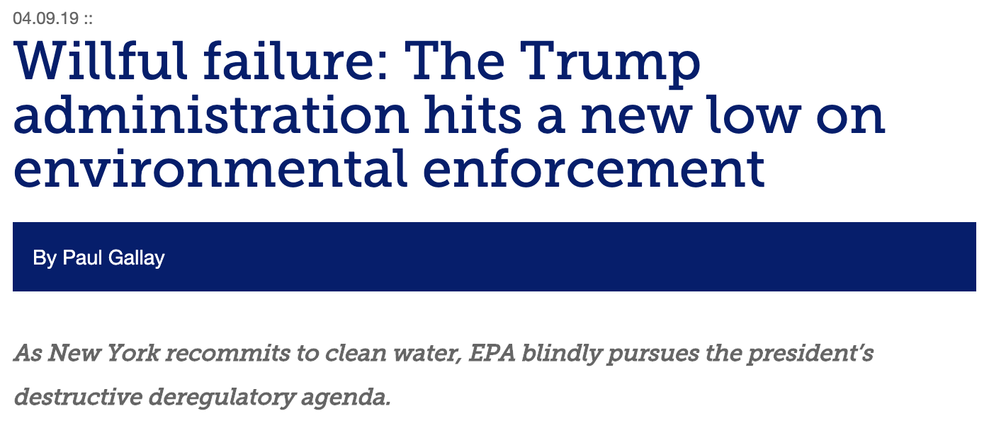
“The total number of compliance inspections by EPA has dropped by one-third, since 2015.
Total enforcement cases resolved — down by 50%, since 2017.
Compliance spending by polluters has also plunged by half, since 2015.
Significant violations of the Clean Water Act at major facilities and high priority violations of the Clean Air Act have collectively spiked by 19%, in the past four years. And,
The total number of enforcement office staff at EPA fell by 16%, in the first 18 months of Trump’s presidency.”
Notes:
From https://waterkeeper.org/willful-failure-trump-administration-hits-new-low-environmental-enforcement/

Slide 9
Pelletier et al
Objective: Predict conservation status of land plant species based on publicly available data.
“Our results indicate that a large number of unassessed species have a high probability of being at risk, and these probabilities can be used to establish assessment prioritization.”
Predictions across space
Application: create guide for identifying species of concern; preserve biodiversity
They are careful to talk about variables’ importance for prediction without invoking the language of inference.
“Although we did identify trends in the variables that contribute the most to at-risk classifiers across continents, there is no one single global variable that predicts conservation status.”
They use the language “explanatory variable” which makes me a little uncomfortable.

Slide 10
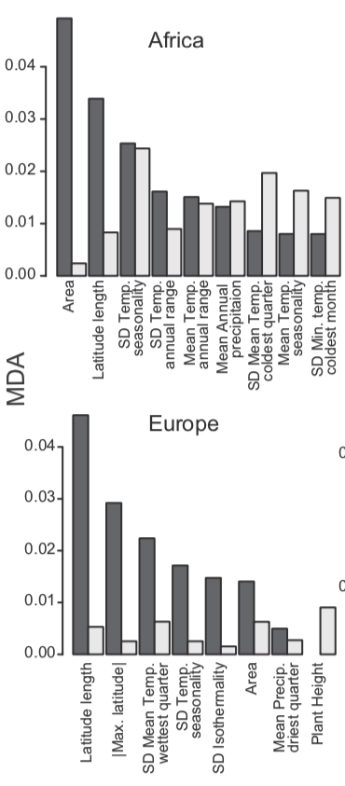
Pelletier et al, ctd
Some points of caution
Be careful interpreting the error rate
“Mean decrease in accuracy” metrics need to be interpreted with caution
We will get to both issues later in the semester.
Strikingly different non-LC probabilities for different training data sets.

Slide 11
Comparing the papers
Hino et al have more obvious justice and fairness implications. Bias, it could be argued, matters more here.
Both have a common objective of predicting something we have not yet measured

Slide 12
Do these approaches really work? Go find out!

Slide 13
Questions for data cleaning
Do you see missing values?
Are there cells where missing values were obviously filled in?
Are there cells where values are clearly wrong?
Are there values where two entries could mean the same thing? Often human-entered values, e.g.:
canine and k9;
recommend and recommend,
Zürich and Zurich etc

Slide 14
Data merging
How many rows and columns do you have when you start?
How many do you have after the merge?
What’s missing? Is it acceptable to you if you’ve lost some data?
We’ll return to this when we talk about faithfulness and scope.
I wrote a script for the class to use in the upcoming homework that helps decipher what data gets lost.

Slide 15
As we proceed, let’s play with the PurpleAir data set.
First, a little more on PM. Sources:
Many sizes and shapes and can be made up of hundreds of different chemicals.
Some directly from a source: construction sites, unpaved roads, fields, smokestacks or fires.
Most form in the atmosphere by complex reactions of chemicals such as sulfur dioxide and nitrogen oxides

Slide 16
More on PM2.5…
(text adapted from epa.gov) Health effects:
premature death in people with heart or lung disease
nonfatal heart attacks
irregular heartbeat
aggravated asthma
decreased lung function
increased respiratory symptoms, such as irritation of the airways
Environmental effects
makes lakes and streams acidic
changes the nutrient balance in coastal waters and large river basins
depletes soil nutrients
damages sensitive forests and farm crops
affects the diversity of ecosystems
contributes to acid rain

Slide 17
Exploratory Data Analysis (EDA)
One can approach EDA by asking questions about the data:
Structure
Granularity
Scope
Temporality
Faithfulness

Slide 18
Structure – how are the data stored?
Are the data in a standard format or encoding?
Tabular data: CSV, TSV, Excel, SQL
Nested data: JSON, XML
Are the data organized in records (e.g. rows)? If not, can we define records by parsing the data?
Are the data nested? If so, can we reasonably un-nest the data?
Do the data reference other data? If so, can we join the data?
What are the fields (e.g. columns) in each record? What is the type of each column?

Slide 19
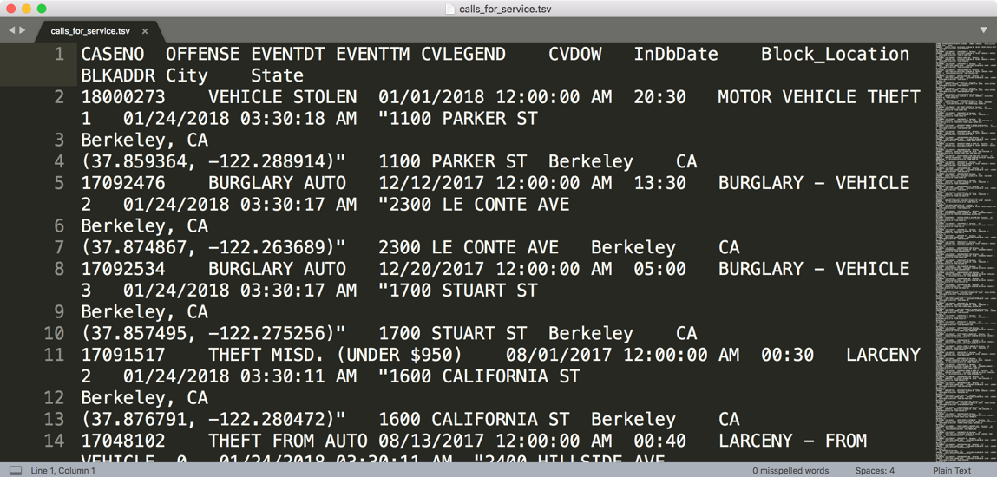
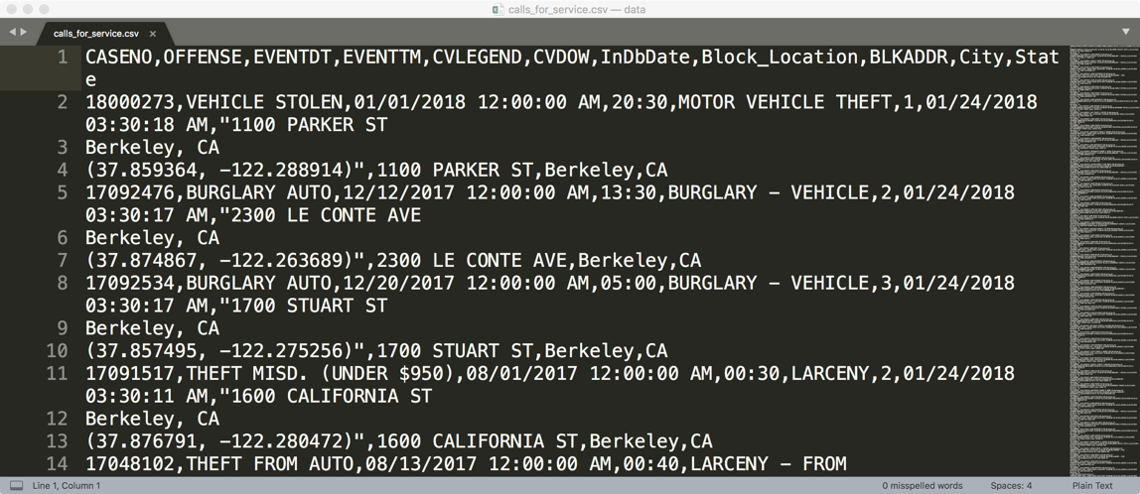
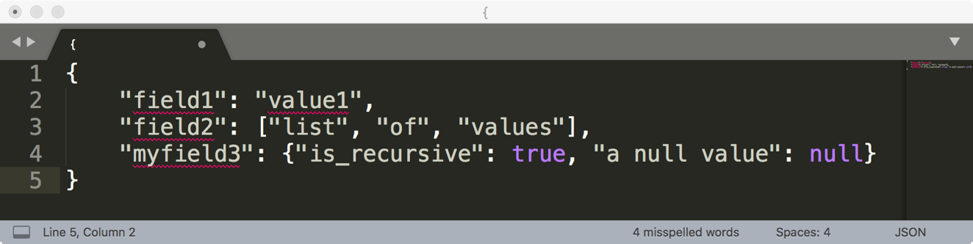
How are these data files formatted?
TSV
Tab separated values
Which is the best?
CSV
Comma separated values
JSON

Slide 20
Comma and Tab Separated Values Files
Tabular data where
records are delimited by a newline: “\n”, “\r\n”
Fields are delimited by ‘,’ (comma) or ‘\t’ (tab)
Very Common!
Main issue?
Some things that are part of the record get interpreted as delimiters: Commas, tabs, quotation marks

Slide 21
JavaScript Object Notation (JSON)
Squiggly brackets act as 'containers’
Square brackets holds arrays
Names and values are separated by a colon.
Array elements are separated by commas

Slide 22
JavaScript Object Notation (JSON)
Widely used file format for nested data
Natural maps to python dictionaries (many tools for loading)
Strict formatting ”quoting” addresses some issues in CSV/TSV
Issues
Each record can have different fields
Nesting means records can contain records → complicated
Side note: look at the “raw” form of the .ipynb files! (They’re JSON.)

Slide 23
Granularity – how are the data aggregated?
What does each record represent?
a purchase, a person, a group of users?
A home, a city, a country?
A minute, an hour, a year?
Do all records capture granularity at the same level?
Data sometimes includes summaries as records
If the data are coarse how was it aggregated?
Sampling, averaging, summing…
What additional kinds of aggregation is possible/desirable?
From individual people to demographic groups?
From individual events to totals across time or regions?
Hierarchies (city/county/state, second/minute/hour/days)

Slide 24
Scope – how much time, how many people, what spatial area?
Does the data cover the topic of interest?
Subset of a population?
Specific range in time
Specific location
How complete are the data?
Are countries missing?
Are periods of time missing?

Slide 25
Lecture 6 stopped here (and covered up to Scope in the ipynb as well)

Slide 26
Temporality: How is time represented in the data?
What is the meaning of the date and time fields in the dataset?
Beware of time zones, daylight savings!
What representation do the date and time fields have in the data?
Are there funky timestamps that might represent null values or cloud your interpretation?

Slide 27
Faithfulness: are the data trustworthy?
Faithful data lack:
Unrealistic or incorrect values
Violations of obvious dependencies
E.g. age and birthday for individuals don’t match
E.g. sorting by record ID gives different result than sorting by time in PurpleAir data
Hand-entered data
Spelling errors, etc.
Clear signs of falsified data
E.g. repeated names, fake looking email addresses, or repeated use of uncommon names or fields.

Slide 28
Summary: How do you “do” EDA?
Examine data and meta-data:
What is the date, size, organization, and structure of the data?
Examine each field/attribute/dimension individually
Examine pairs of related dimensions
Stratifying earlier analysis: break down grades by major …
Along the way:
Visualize/summarize the data (next time!)
Test your assumptions about the data, for example
“The range should be…”
“Sudden changes should not occur...”
Identify anomalies and either change update your assumptions or modify the data.
Record everything you do! (why?)

